Slide 1

Slide 1
ACCENTURE PROJECT
- PowerPoint Presentation -

Slide 2
AGENDA
Project Description
Problem statement
Process
Insights
Summary

Slide 3

Project Description
Audit Social Buzz’s big data practice
Social Buzz has scaled massively over the coupe of months reaching about 500 million active users monthly. Therefore, the project was initiated to oversee the scaling process and examine its data management practices
Provide recommendations for a successful IPO
Analyze the top 5 most popular content categories

Slide 4


Process
Data Understanding
Data Extraction & Cleaning
Data Modeling and Processing
Data Visualization
Decision Making

Slide 5
Insights
Top 5 Content Categories
Animals had the largest percentage of posts and reactions
Animals
21.5%
Science
20.4%
Healthy Eating
19.5%
Food
19.3%
Technology
19.3%

Slide 6
Monthly Trends
May had the highest number of posts while January had the highest number of reactions
56.2%
Reactions were positive

Slide 7






Slide 6
Sentiment Score
Animals had the highest sentiment total score of 74965

Slide 8
Reactions
12.5%
Neutral Reactions
31.3%
56.2%
Negative Reactions
Positive Reactions

Slide 9
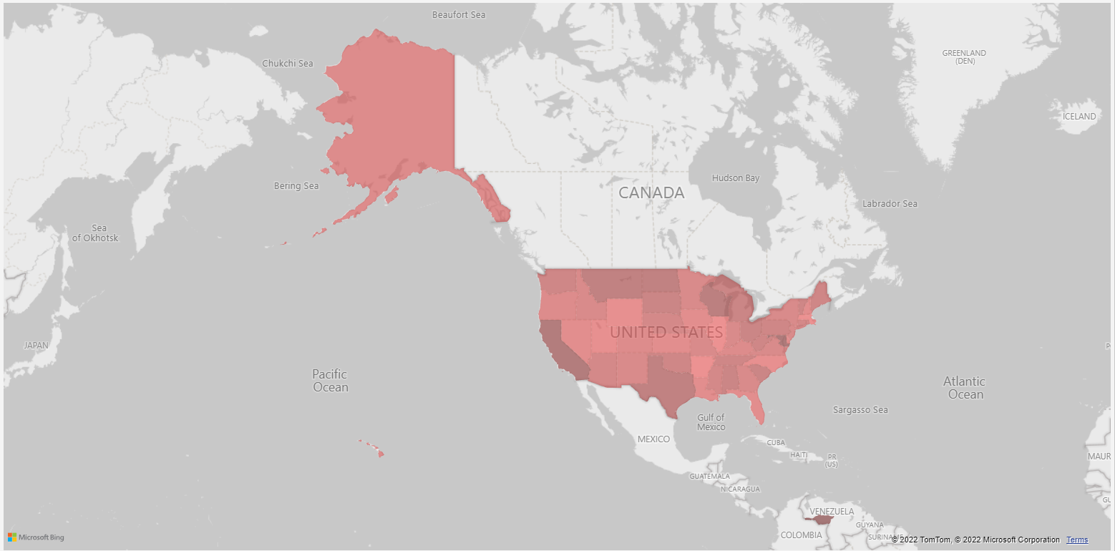
User distribution

Slide 10
Summary
We tackled this task and found the top 5 most popular categories as asked, but we also went one step further.
Animals and Science are the most popular categories
Healthy eating, Technology and Food are next most popular items.
As much as this analysis was insightful, we are ready to take it to the next stage and we have the expertise within Accenture to help you realize these kinds of insights in production across your organization and in real time. We would love to help you with this.

Slide 11
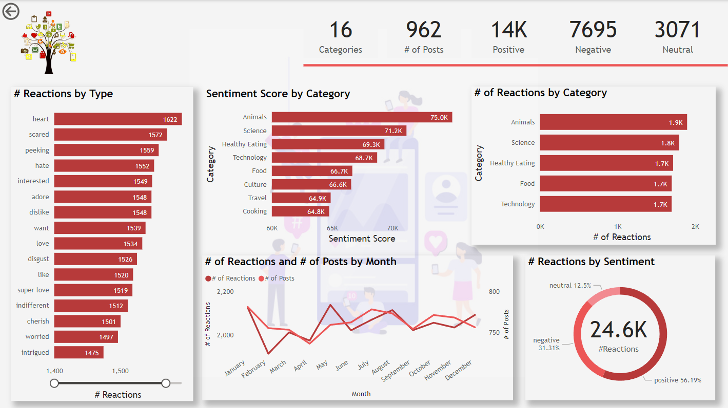

Slide 12

Slide 10
THANK YOU

